Slide 1

AI-Powered Business Performance & Decision Intelligence System for SMEs
Presented By:
Student Name- Mannat Sharma
College Name- Sanatan Dharma College , Ambala Cantt
Department – BBA | Commerce And Management
4. AICTE ID - STU6a2da00d593fb1781374989

Slide 2
OUTLINE
Problem Statement (Should not include solution)
Proposed System/Solution
System Development Approach (Technology Used)
Algorithm & Deployment
Result
Conclusion
Future Scope
References

Slide 3
Problem Statement
Small and Medium Enterprises (SMEs) operate in highly competitive environments but lack access to affordable, centralized business intelligence tools that large corporations rely on for data-driven decision making.
Key Challenges faced by SMEs today:
Business data is scattered across multiple spreadsheets, tools, and departments with no single unified view
Sales performance, customer behavior, expenses, and employee KPIs are tracked manually or not tracked at all
Business owners and managers make critical decisions based on gut feeling rather than real data and trends
There is no easy way to identify which customers are at risk, which products are underperforming, or where costs are exceeding budgets
SMEs cannot afford expensive BI tools like Tableau, Power BI, or SAP which are built for large enterprises
Without early warning systems, problems like revenue decline, expense overruns, and customer churn go unnoticed until it is too late
There is no intelligent system that can automatically analyse business data and provide actionable recommendations to management

Slide 4
Proposed Solution
AI-Powered Business Intelligence Platform
We propose a web-based Business Performance and Decision Intelligence System specifically designed for SMEs that centralizes all business data and provides intelligent, real-time insights through an easy-to-use interface.
The system provides:
A single unified platform accessible from any browser — no installation required
Role-based access control so Administrators, Managers, and Employees each see what is relevant to them
An interactive Executive Dashboard with live KPI cards, trend charts, and business health gauges
Dedicated modules for Sales, Customer Relationship Management, Expenses, Employee Performance, Business Targets, and Reports
An AI-powered Business Insight engine using Google Gemini 3.6 Flash LLM that automatically reads all business data and generates executive summaries, identifies risks, spots opportunities, and gives strategic recommendations
An interactive Q&A feature where managers can ask any business question in plain English and receive a data-driven answer instantly
Zero dependency on expensive enterprise software — fully free to deploy and run

Slide 5
System Approach
The development of this system follows a modular, data-driven approach divided into the following stages:
Stage 1 — Data Layer
A centralized data engine generates and manages 18 months of realistic SME business data
Data covers sales transactions, customer records, expense entries, employee performance records, and monthly business targets
All data is structured using Pandas DataFrames and cached for fast performance
Stage 2 — Processing & Analytics Layer
Raw data is aggregated, filtered, and transformed into meaningful business metrics
KPIs such as Revenue Growth, Gross Profit Margin, Win Rate, Net Profit, and Target Achievement are computed automatically
Trend analysis, period comparisons, and performance scoring are applied across all modules
Stage 3 — Visualization Layer
Interactive charts and graphs are built using Plotly — bar charts, line charts, scatter plots, heatmaps, radar charts, funnels, treemaps, and gauges
All visualizations are filterable and drill-down enabled
Stage 4 — AI Intelligence Layer
Business context is compiled from all data modules into a structured snapshot
This snapshot is sent to Google Gemini 3.6 Flash LLM via API
The model returns professional business analysis including trends, risks, opportunities, and prioritized recommendations
Managers can also ask free-form questions and receive instant AI-generated answers
Stage 5 — Access Control Layer
Role-based authentication ensures each user type sees only relevant modules and data
Three roles — Administrator, Manager, Employee — with different permission levels

Slide 6
System Requirements
Hardware Requirements:
Any computer or laptop with a modern web browser
Minimum 4GB RAM recommended
Internet connection required for AI features and cloud deployment
Software Requirements:
Python 3.9 or above
Web Browser — Chrome, Firefox, or Edge (latest version)
Git — for version control and GitHub deployment
Streamlit Community Cloud account — for free hosting and deployment
Google AI Studio account — for Gemini API key (free tier available)
Platform:
Developed and tested on Windows 10/11
Deployable on Streamlit Cloud (Linux environment)
Accessible on any device including mobile browsers after deployment

Slide 7
Libraries Required
Library | Version | Purpose
Streamlit | 1.35+ | Web application framework — builds the entire UI using only Python
Pandas | 2.0+ | Data manipulation, aggregation, filtering, and DataFrame management
NumPy | 1.24+ | Numerical computations, statistical calculations, and data generation
Plotly | 5.18+ | Interactive charts — bar, line, scatter, pie, heatmap, radar, funnel, treemap, gauge
Google GenerativeAI | 0.7+ | Official Python SDK to connect with Google Gemini 3.6 Flash LLM API
Why these libraries:
All libraries are open source and completely free
No frontend framework needed — Streamlit handles everything in pure Python
Plotly provides professional-grade interactive charts without any JavaScript
Google GenerativeAI SDK makes LLM integration simple with just a few lines of Python code
Total installation size is lightweight — under 200MB

Slide 8
Algorithm & Deployment 01
Data Input : -
Algorithm Selection:
This system does not use a traditional machine learning algorithm for prediction. Instead it uses Google Gemini 3.6 Flash — a Large Language Model (LLM) — for intelligent business analysis and decision support.
Gemini 3.6 Flash was selected because:
Business intelligence requires reasoning, summarization and recommendation — not just numerical prediction
It can analyse multi-dimensional business data covering sales, expenses, customers and employees all at once
It generates human-readable strategic insights that a business manager can directly act upon
It supports free-form Q&A so managers can ask any business question in plain English
It is available via a free API tier making it suitable for SMEs with limited budgets
Input Data | Description
Revenue KPIs | Total revenue, growth rate, gross profit, GP margin
Expense Data | Monthly expenses by category, budget vs actual
Sales Data | Monthly trends, product performance, rep performance, win rate
Customer Data | Top customers, at-risk customers, health scores, acquisition trends
Employee Data | KPI scores by department, attendance, task completion, ratings
Target Data | Revenue, expense, GP margin and customer acquisition targets vs actuals

Slide 9
Algorithm & Deployment 02
Training Process:
Since Gemini 3.6 Flash is a pre-trained foundation model, no custom training is required. The system instead uses Prompt Engineering as its core methodology:
A detailed system prompt defines the AI persona as a Senior Business Intelligence Analyst
A business context prompt is dynamically built from 18 months of live business data
The prompt instructs the model to identify trends, flag risks, highlight opportunities and provide prioritized recommendations
Temperature is set to 0.4 to ensure responses are focused, consistent and professional rather than creative or random
Five specialized prompt templates are used — Full Review, Revenue Analysis, Cost Analysis, Customer Intelligence and Workforce Analysis
Analysis Process:
Step | Process
Step 1 | User selects an analysis module or types a question
Step 2 | System compiles all relevant business data into a structured text snapshot
Step 3 | Snapshot + specialized prompt is sent to Gemini 3.6 Flash API
Step 4 | Gemini analyses the data and returns a detailed business report
Step 5 | Report is displayed in the app with sections for Summary, Risks, Opportunities and Recommendations
Step 6 | User can ask follow-up questions via the interactive Q&A tab

Slide 10
Algorithm & Deployment 03
Deployment:
Component | Details
Version Control | GitHub — source code hosted at github.com/Mannat-Sharma-git/BizInsights
Hosting Platform | Streamlit Community Cloud — free, one-click deployment
Main File | app.py
Live URL | https://bizinsights.streamlit.app/
Access | Available on any device via browser — desktop, tablet or mobile

Slide 11
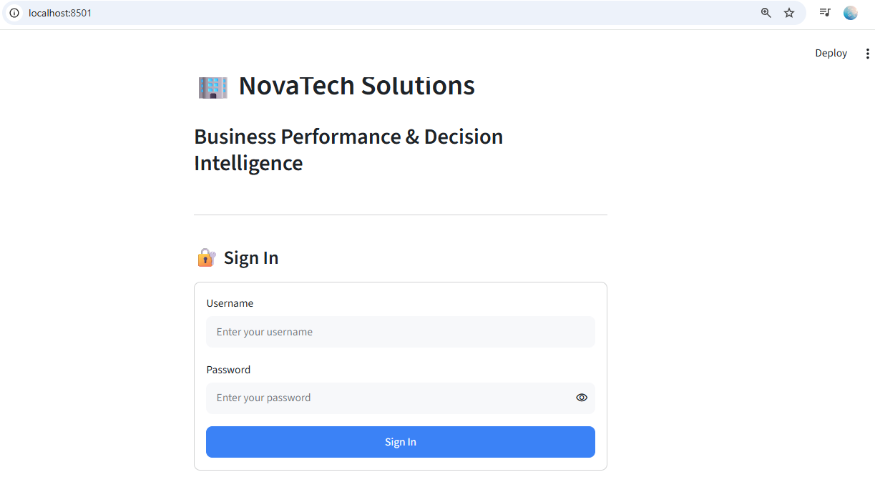
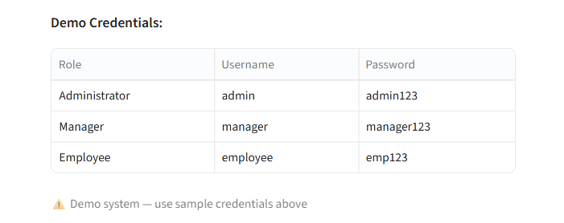
Result

Slide 12
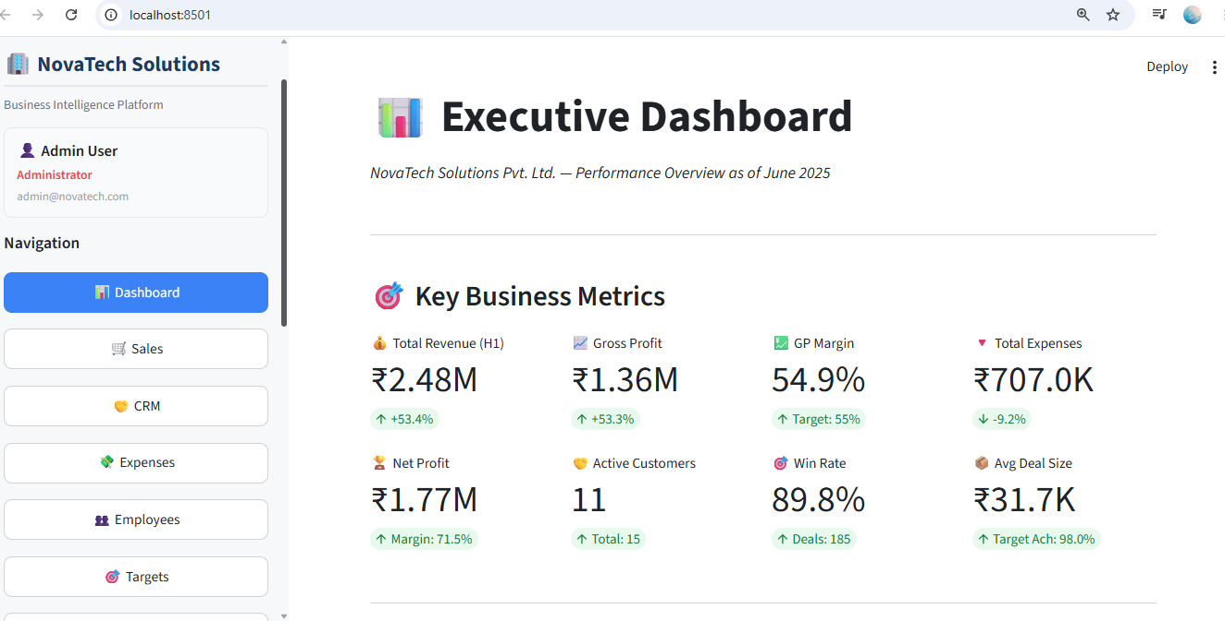
Result

Slide 13
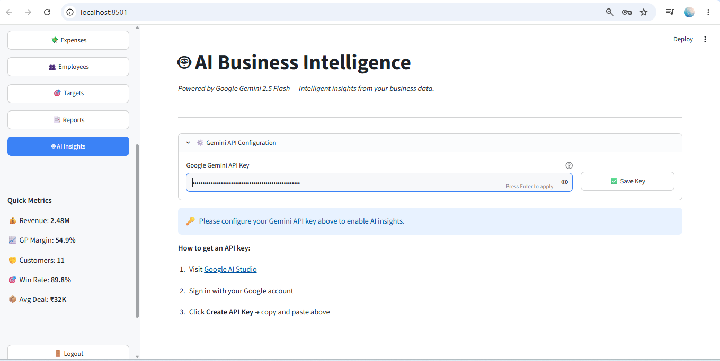
Result

Slide 14
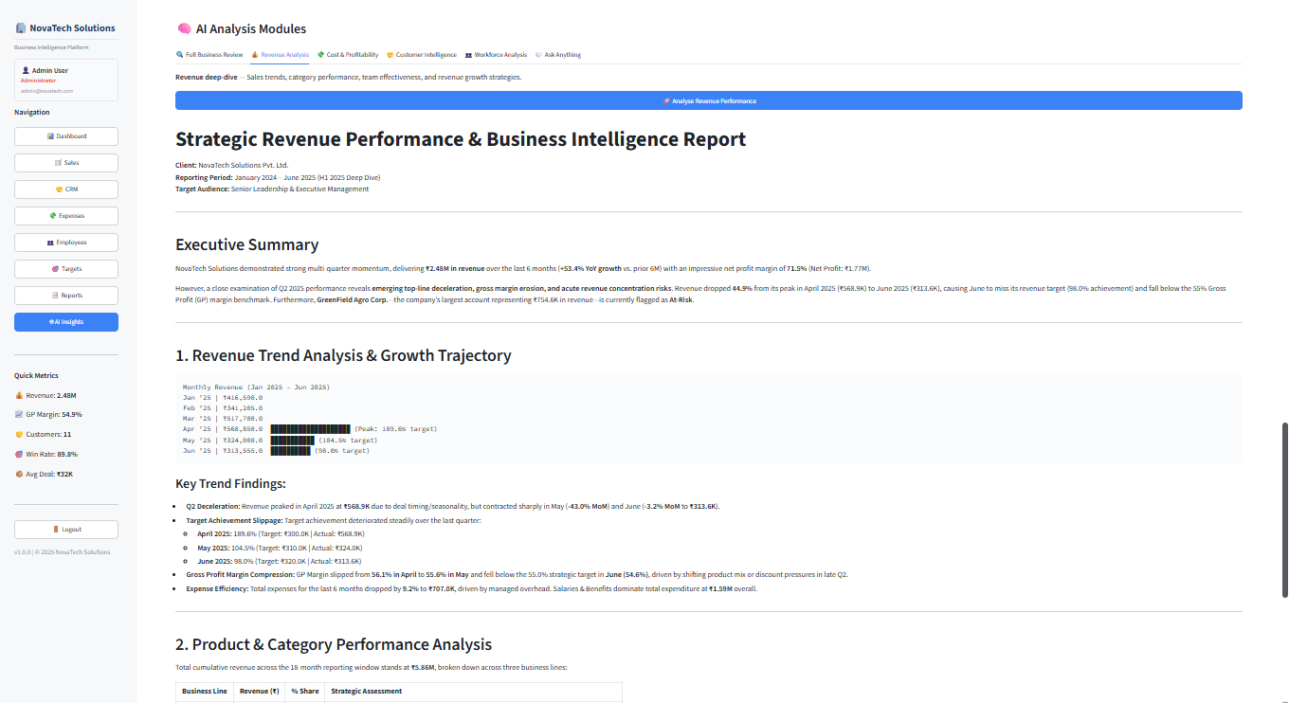
Result

Slide 15
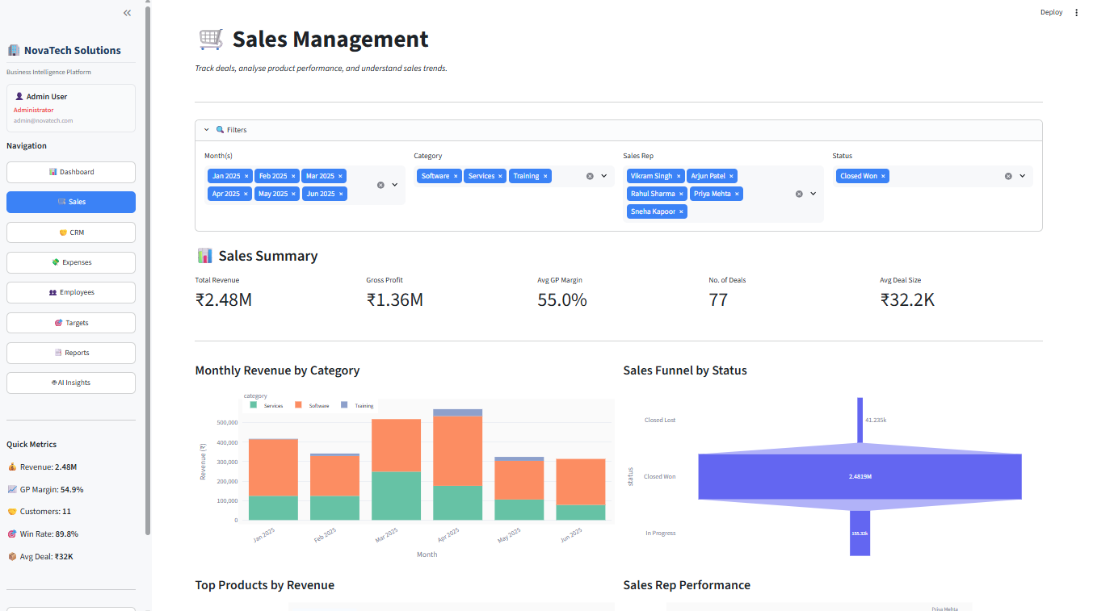
Result

Slide 16
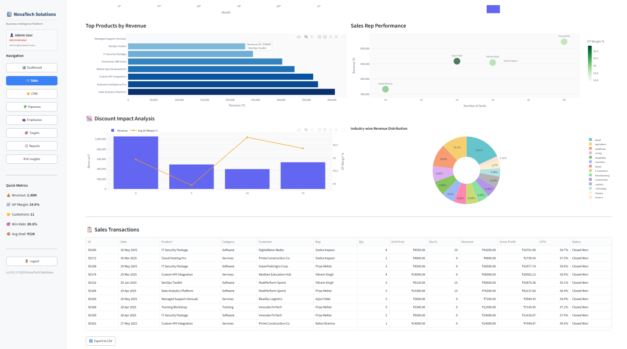
Result

Slide 17
Conclusion
Summary:
This project successfully built and deployed an AI-Powered Business Performance and Decision Intelligence System for SMEs using 100% Python — no HTML, CSS or JavaScript — with Streamlit and Google Gemini 3.6 Flash LLM.
Key Outcomes:
Centralized platform covering Sales, CRM, Expenses, Employees, Targets and Reports in one place
AI generates a complete business review with risks, opportunities and recommendations in under 10 seconds
Role-based access ensures the right people see the right data
Deployed live on Streamlit Cloud — accessible from any device for free
Challenges Faced:
Gemini 3.6 Flash model was deprecated mid-development — updated to Gemini 3.6 Flash
GitHub folder structure had to be corrected for successful cloud deployment
Building a professional UI using only Python Streamlit components without any HTML or CSS
Final Remark:
"This system proves that Artificial Intelligence is no longer exclusive to large corporations — SMEs can now make faster, smarter and more confident business decisions using free, open-source tools."

Slide 18
Future scope
1. Advanced AI & Machine Learning Integration:
Replace prompt-based analysis with a fine-tuned LLM trained specifically on SME business data for more accurate domain-specific insights
Add time-series forecasting using LSTM or Prophet models to predict future revenue, expenses and customer churn
Implement anomaly detection algorithms to automatically flag unusual spikes in expenses or sudden drops in sales
2. Additional Data Sources:
Integrate with live databases such as MySQL and PostgreSQL for real business transaction data
Connect with ERP and accounting software like Tally, QuickBooks or Zoho Books via APIs
Pull social media and market sentiment data to correlate external trends with business performance
3. System Expansion:
Add multi-company support so multiple SMEs can use the same platform with isolated data environments
Build a mobile application for on-the-go KPI monitoring by business owners
Enable automated email and WhatsApp alerts when critical KPIs fall below set thresholds
4. Emerging Technologies:
Integrate Retrieval Augmented Generation (RAG) so the AI can reference historical reports and past decisions when generating new recommendations
Apply Natural Language Processing (NLP) to analyse customer feedback and reviews and include sentiment scores in the CRM module
Use AutoML to automatically select and train the best forecasting model based on available business data patterns
5. Performance Optimization:
Shift from cached sample data to real-time streaming data pipelines using Apache Kafka or AWS Kinesis
Add role-specific personalized dashboards that learn from user behavior and surface the most relevant metrics automatically

Slide 19
References
Python Software Foundation. (2024). Python 3.14.6 Standard Library Documentation. link
Streamlit Inc. (2024). Streamlit Documentation. link
Google DeepMind. (2024). Gemini API Documentation. link
Plotly Technologies. (2024). Plotly Python Library. link
The Pandas Team. (2024). Pandas Documentation. link
NumPy Developers. (2024). NumPy Documentation. link
Sharma, M. (2025). BizInsights — AI-Powered BI System for SMEs. GitHub. link
Google AI Studio. (2024). Gemini Prompt Engineering Guide. link

Slide 20
Deployment link / github link
Github Link: Open-BizInsights-Repository
Deployment: streamlit

Slide 21

THANK YOU

